Slide 1

We all work to earn save money

Slide 2

But There is a Limit on how much we can keep at Home

Slide 3

People waiting in line to collect money

Slide 4

SOLUTION ?

Slide 5

The Simplest yet most effective Answer is Banks

Slide 6

The Bank Management System
We Introduce You

Slide 7
What is Bank?
“A bank is a financial institution that is licensed to accept checking and savings deposits and make loans.”
B = Borrowing
A = Accepting
N = Negotiating
K = Keeping

Slide 8
Origine
“The word bank comes from an Italian word banco, meaning a bench, since Italian merchants in the Renaissance made deals to borrow and lend money beside a bench. They placed the money on that bench”.
MDPS, is the oldest surviving bank in the world. It was founded in 1472 !.
The first bank of India was the “Bank of Hindustan”, established in 1770 and located in the then Indian capital, Calcutta.

Slide 9
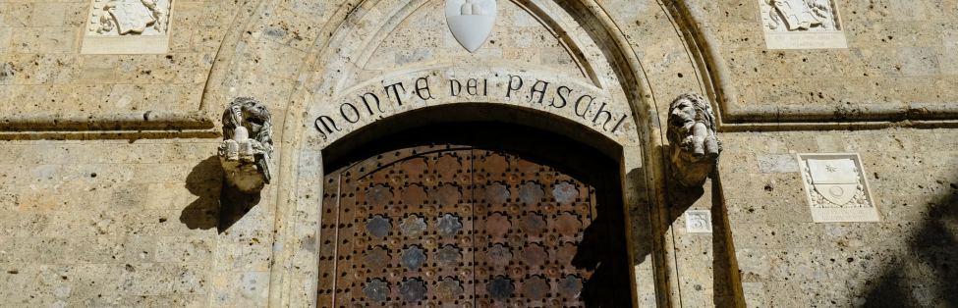
Worlds First Bank

Slide 10
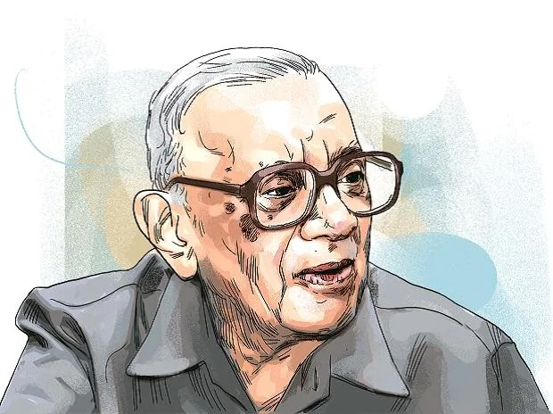
Father of indian banking
Maidavolu Narasimham who served as the 13th governor of the RBI, he is often referred to as the father of banking in India.

Slide 11
Importance of Banking
Acceptance of deposits
Advancing of loans to needy persons
Making new investments in different organizations and increasing the productive capacity of the country
Promote capital formation in the country by mobilizing and collection of savings for the purpose of investments
Development of industries in the country according to the requirements of the economy
Balanced development in the economy is achieved in different sectors & regions through the resources of bank funds
Development in agricultural production is made possible by providing different kinds of loans
These banks help in reducing reliance on foreign assistance by their efforts in the mobilization of domestic savings
These banks help in the implementation of an effective monetary policy according to the objective to the central bank.
Commercial banks also help in the creation and distribution of money through the sales and purchase of securities.

Slide 12
As of 2021, there were nearly 100 thousand scheduled banks in India, including around 98 thousand comparatively small rural and urban cooperative banks.
Banks are “special” because they manage the payment system through which most economic payments are made

Slide 13
Advantages of net banking
Net banking is available 24/7
It allows for easy fund transfers
It offers convenience for conducting banking transactions
Customers can easily track their transaction history with just a few clicks
Net banking is secure and requires a password for access
Non-financial activities such as ordering a cheque book, checking account balance, and obtaining a passbook can be easily done through net banking.

Slide 14
We have Developed to manage the Database of the “BANKING SYSTEM”

